Slide 1
MOOD
Emotional Rescuer
Group 37-Cheely
Zhaoyu Yan,
Yueqiu Zhong,
Qianning Lian,
Yitian Xiao,
Zhichao Hao,
Zeyang Ni
01
Notes:
Hello everyone, we are the group Cheely, and today we will be presenting our Mood project, which we hope would become an emotional rescuer for international students

Slide 2

The Problem
Notes:
The motivation of this project is actually our personal experience and stories we have heard of.
Many international students friends I knew have experienced anxiety disorders and depression before.
I personally also experienced many difficulties and bad mood at the early stage of studying abroad.
The mental health problem of international students is getting worse during the pandemic,
While some domestic students could return home, many international students could not go back to their home countries, either because of the cost or border restrictions policies.

Slide 3
Problem Statement
International students need to dispel loneliness by themselves and make friends with both local students and students from the same country, because they are likely to experience loneliness when living in a foreign country without friends and relatives especially at the early stage.
Notes:
The goal of our design is to help international students dispel loneliness, and help them build connections with both local students and students from the same country.

Slide 4

Stakeholders
Primary: International Students
Secondary: Family of International Students
College and University
(i.e. Centre for International Experience)
Notes:
Besides international students themselves, we also found that the family members of international students and universities could also be affected.

Slide 5


Slide 6
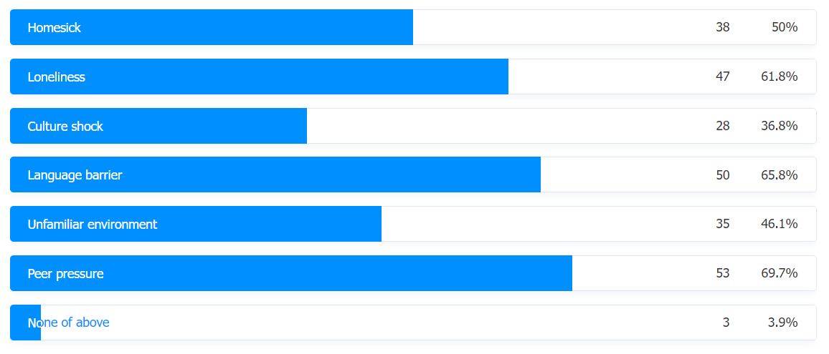
Formative Study 1
Questionnaire
Recruitment: Canadian international students
Takeaways:
Tend to feel lonely and emotional at night
The most common concerns and emotions are peer pressure, language barriers, homesickness, and loneliness
Prefer to hang out with friends to adjust their negative emotions
Notes:
To better understand the problem and our stakeholders, we conducted a questionnaire with Canadian international students.
We learned that international students tend to feel lonely and emotional at night. The results show that the most common concerns for them are peer pressure and language barriers, and the most common emotions are homesickness and loneliness. And they prefer to hang out with friends to adjust their negative emotions.

Slide 7
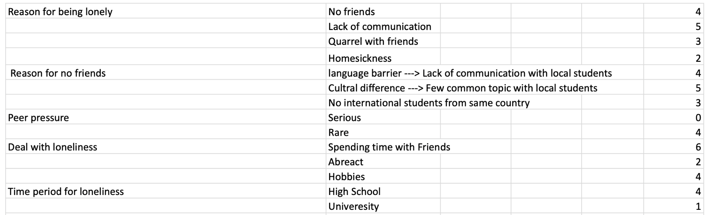
Formative Study 2
Interview
Recruitment: Canadian international students
Takeaways:
Suffer from loneliness due to insufficient communication with others
Hard to make friends in a new environment with a different language and culture
Most of the interviewees do not have serious peer pressure
Notes:
We also conducted interviews to dig into the root cause of our problem space. We learned that international students suffer from loneliness mostly due to insufficient communication with others, and they find it hard to make friends in a new environment with a different language and culture. We also found that although peer pressure was ranked as the most frequent concern, most of our interviewees did not experience serious peer pressure, which means the most common negative emotion is actually loneliness.

Slide 8
Benefits
Prevent serious mental health problem
Build a good community
Help international students’ lives in a foreign country
Notes:
Helping international students dispel loneliness would prevent serious mental health problem.
Our project would also build a good community for international students to share their thoughts, seek for help, and help each other.

Slide 9
Job Stories
We think about several Job Stories under which situation our design might help
Most of the Job Stories are about desire for socialization and friendship
We managed to cover the problems as much as possible, including the problems international students might encounter when they first came to Canada as well as their hard time finding new friends

Slide 10
Design Requirements
Connect people with similar backgrounds and common interests.
Help international students learn local culture and mitigate language barriers
Build connections among classmates
Create a festival atmosphere and help international students plan celebrations
Provide a platform for people to express themselves and help each other with similar experiences
Notes:
Based on our formative studies through questionnaires and interviews, we derived 5 main design requirements.
Mainly to help international students make friends and provide a platform for them to express themselves and help each other.

Slide 11
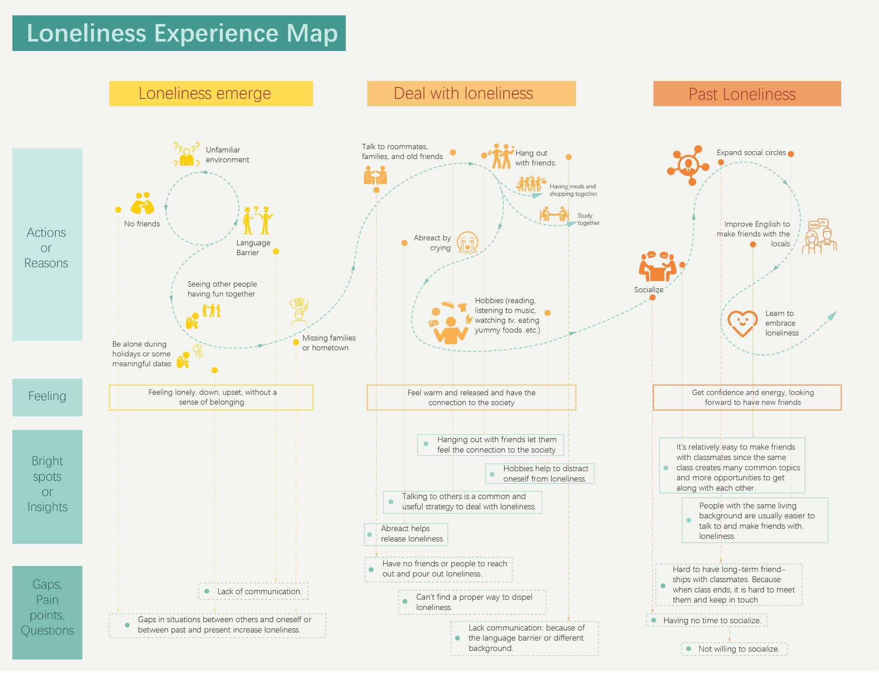
Notes:
Follow the formative study and job stories, we draw the experience map that describes international students’ experience from the emergence of loneliness, dealing with loneliness, to past loneliness. We found that international students would like to find someone to talk to or have shared experience with others so that they can ease their low mood, feel connected and prevent feelings of loneliness and isolation. With this finding, we brainstormed solutions to address the loneliness issue through creating an app to ease their mood and connect international students with their experience and mood.

Slide 12
Storyboards
We pictured 5 Storyboards in toal, including 2 high-level and 3 screen level Storyboards
We imagined several scenarios that could generally cover all the situation that our design could be used
Our Storyboards provide a vivid guidelines for how could our design be used and under what situation could our design be applied.

Slide 13
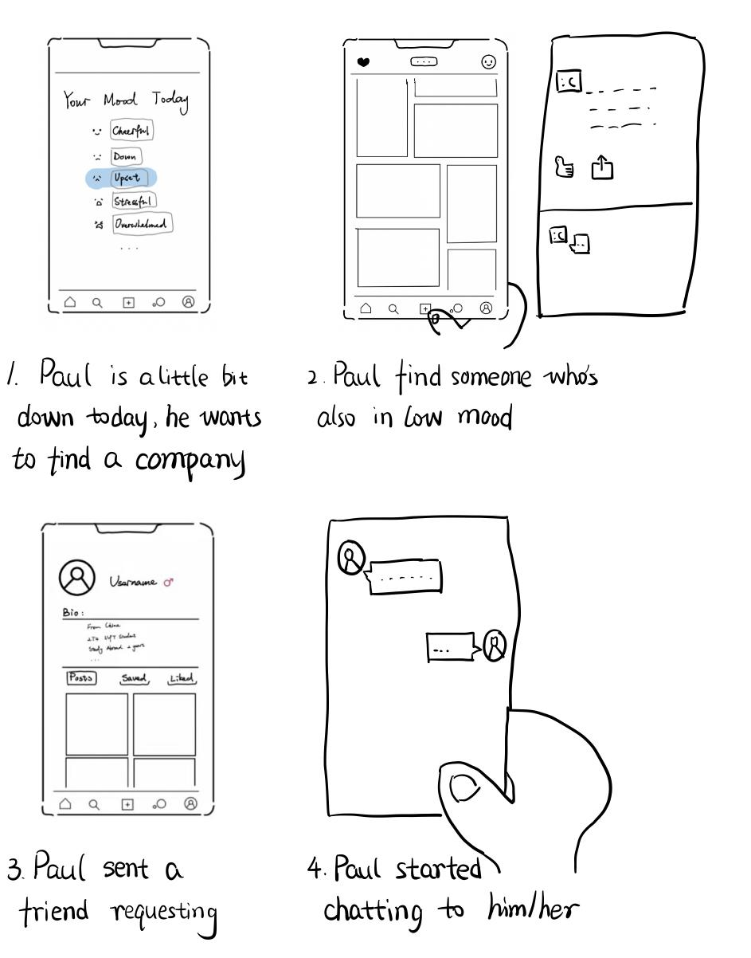
One of our storyboards illustrated a feature of our design that relating people with similar moods, if one user choose a mood for current state, that user can view the content posted by others users that share the same mood
Notes:
In the third scenario, Paul is a little bit down today and he want to find a company on this application, Paul set his mood to “Upset” and find someone who’s also in “Upset” mood. Then Paul sent him/her a friend request and started to chat with with the new friend.

Slide 14
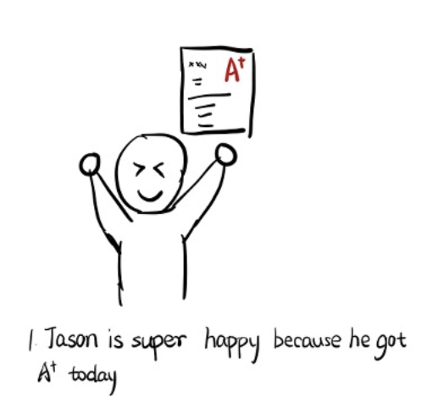
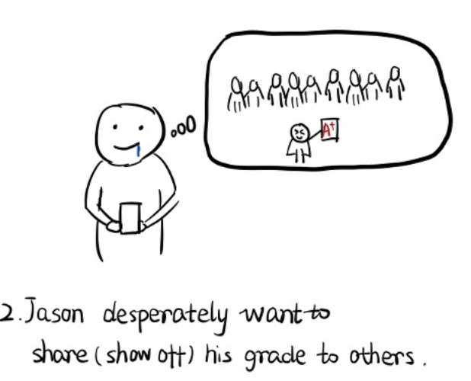
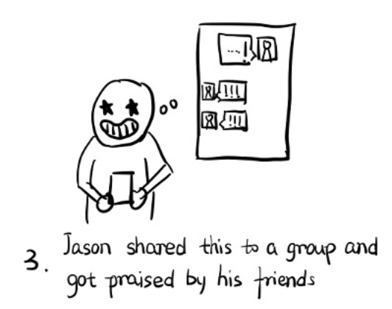
We also have a storyboard that illustrated our group chat feature where a user can send message to a certain group of users which might help for getting new friends.

Slide 15
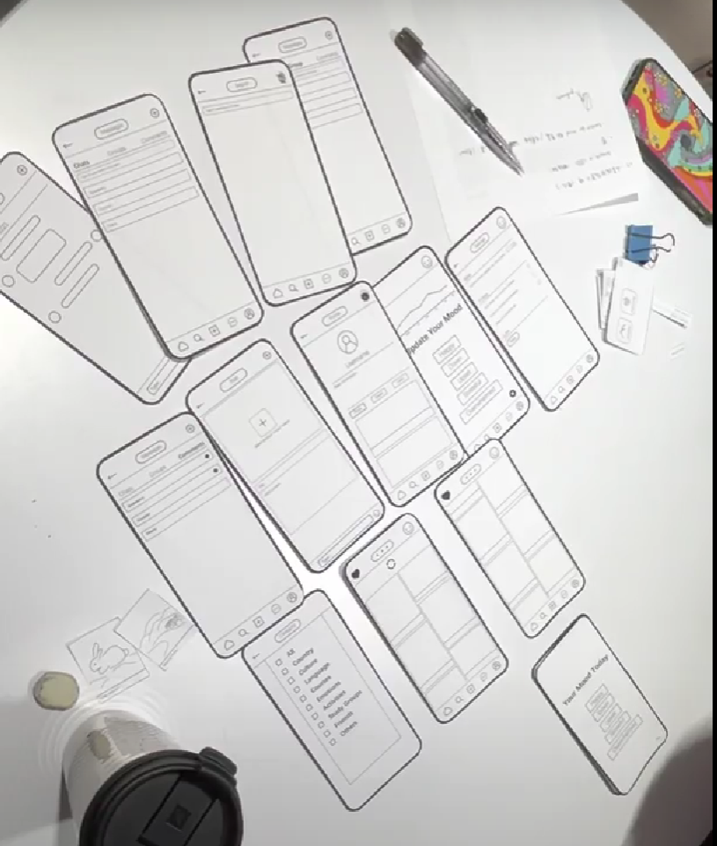
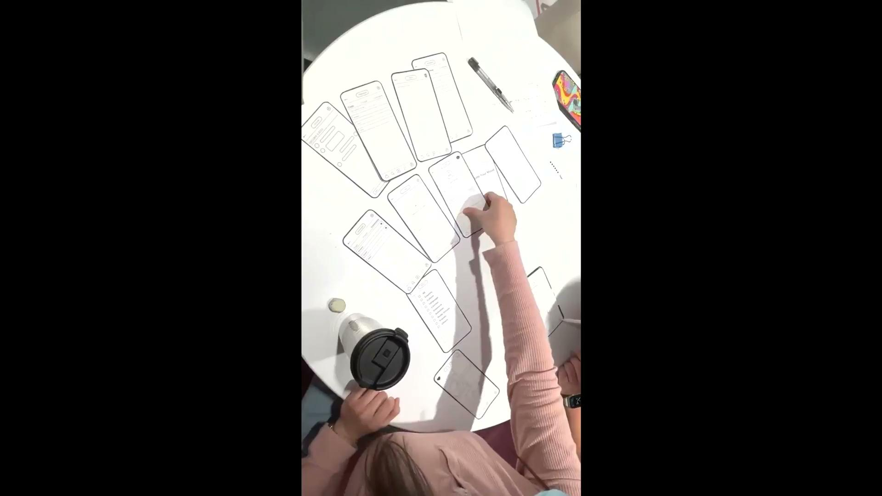
Paper prototype

Slide 16
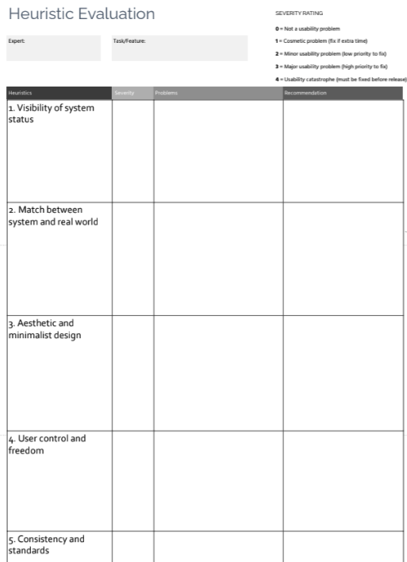
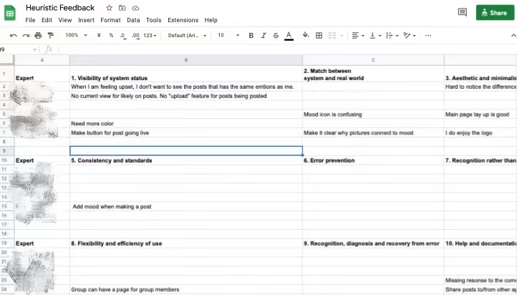
Expert evaluation: Heuristic Evaluation & Think-aloud
Experts that recruited:Students in tutorials
Created a heuristic evaluation form prior to the tutorial
Organized expert feedbacks into heuristic evaluation form
Let the experts to think-aloud during prototype.

Slide 17


Expert evaluation: Heuristic Evaluation & Think-aloud
Improvements and what we learned:
Fixed the problem where some buttons are not consistent for consistency and standards.
Added functionality such as share/report/not interesting for user control and freedom.
Changed the category button to filter button for flexibility and efficiency of use.
Allowed users to edit and update after they share posting for error prevention.

Slide 18
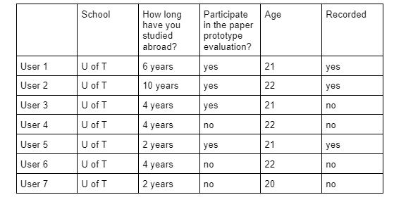
Usability study
Planning Sample-size: 9~12
Target end-users: International students from U of T
Recruitment
Recruit target participants with existing social networks
Recruit experts who helped us with the paper prototype evaluation
(7 out of 9 users)

Slide 19
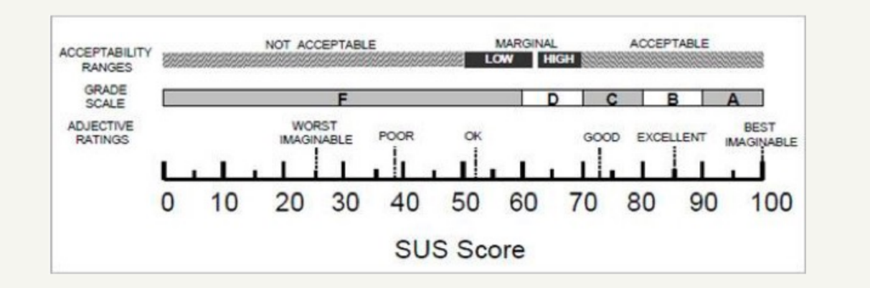
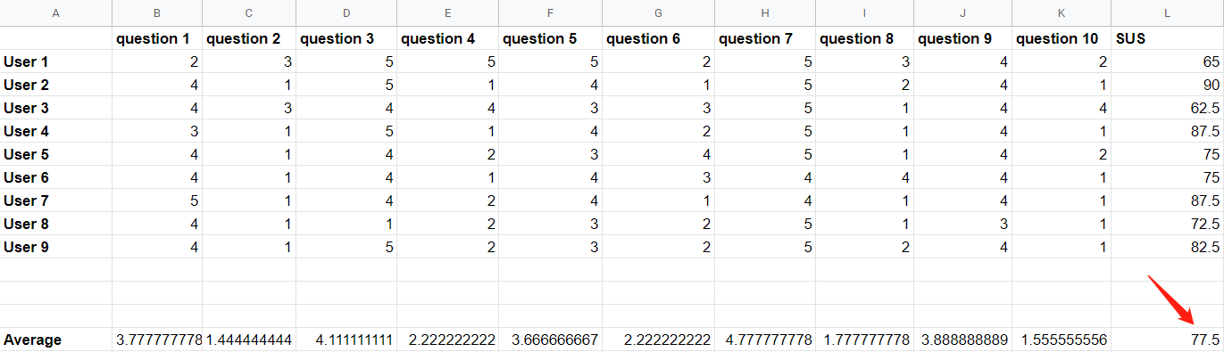
Result of usability study

Slide 20
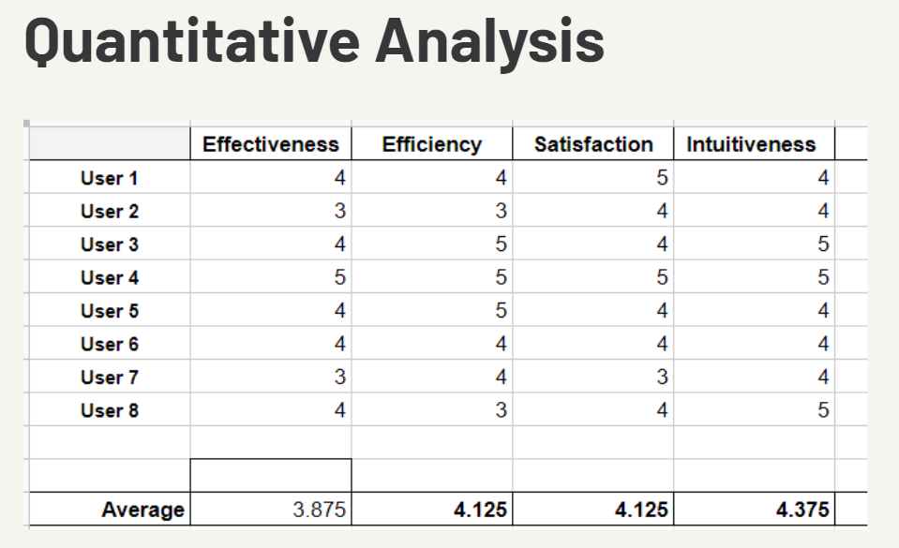
Result of usability study
Bright spots
The overall layout is clean and concise
UI is intuitive and easy to use
Mood function is good
Gaps
“Mood” icon “category ” icon are not convenient to use
filter posts and create group is not clear
too many categories and many of them are unnecessary

Slide 21

DEMO
https://www.figma.com/proto/tFpdCTjfGqjY33kKellQAx/Cheely---High-fidelity-prototype?node-id=22%3A21&scaling=scale-down&page-id=0%3A1&starting-point-node-id=22%3A21&show-proto-sidebar=1

Slide 22
Thank you!

Slide 23
Problem
Formative studies
Job stories
Design requirements
Experience map
Storyboard
Paper prototype
Think-aloud study
Expert evaluation
Usability study
Demo

